Slide 1


Slide 2
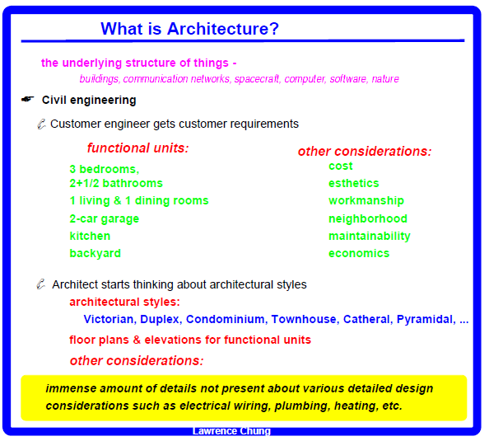

Slide 3
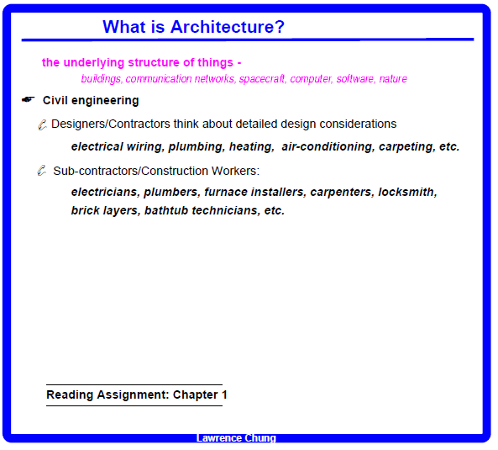

Slide 4
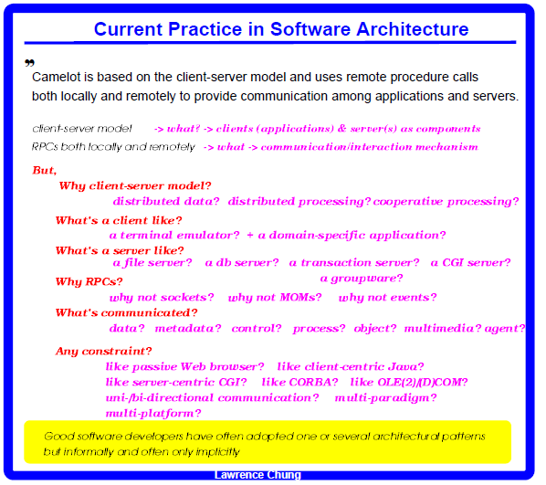

Slide 5
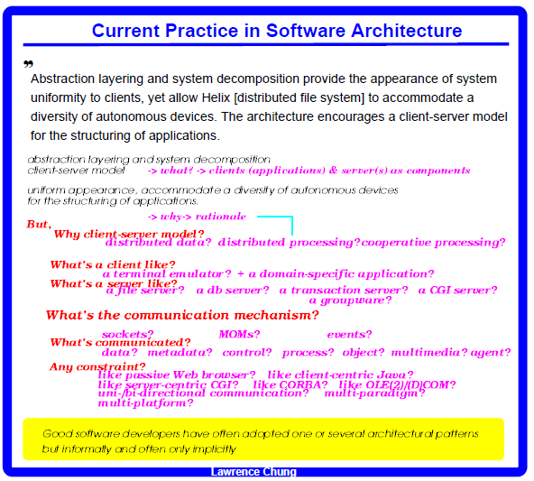

Slide 6
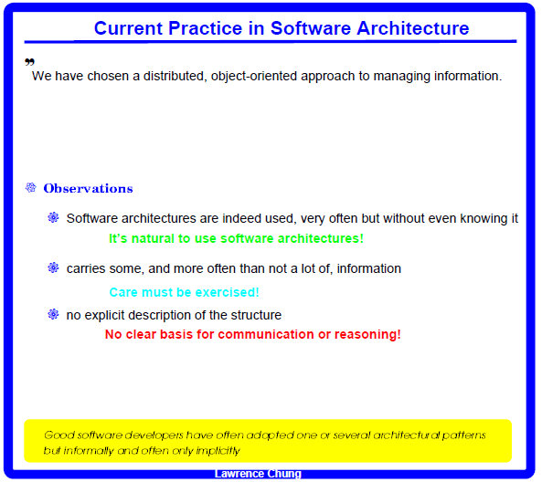

Slide 7
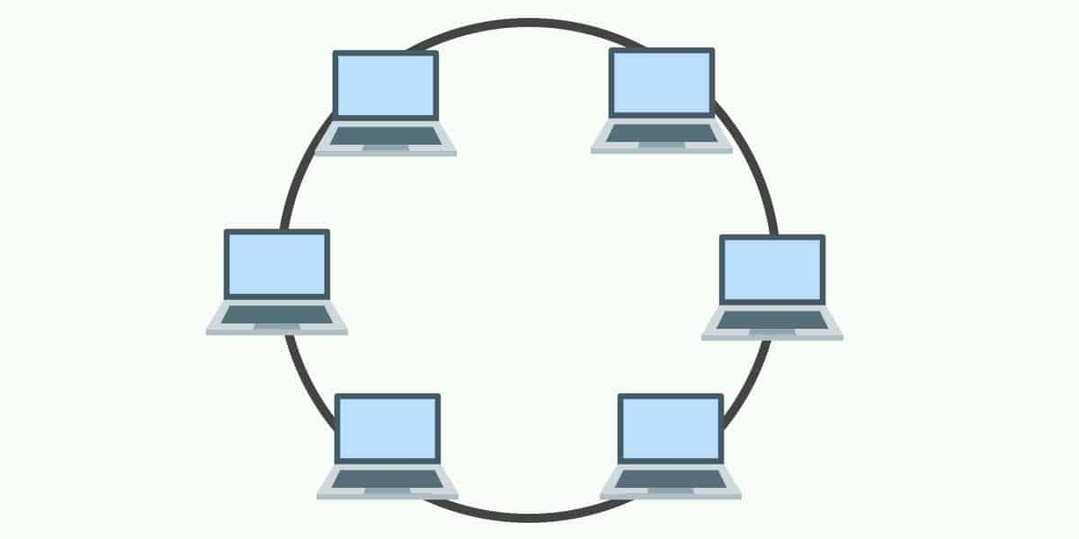
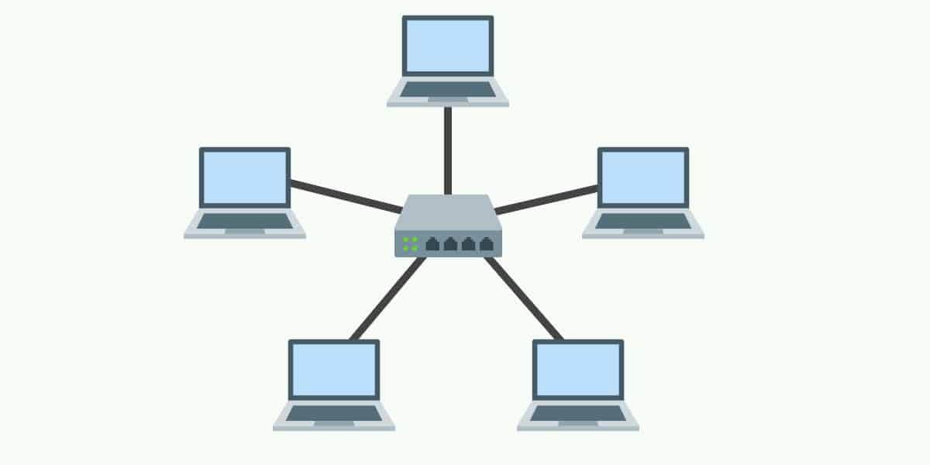
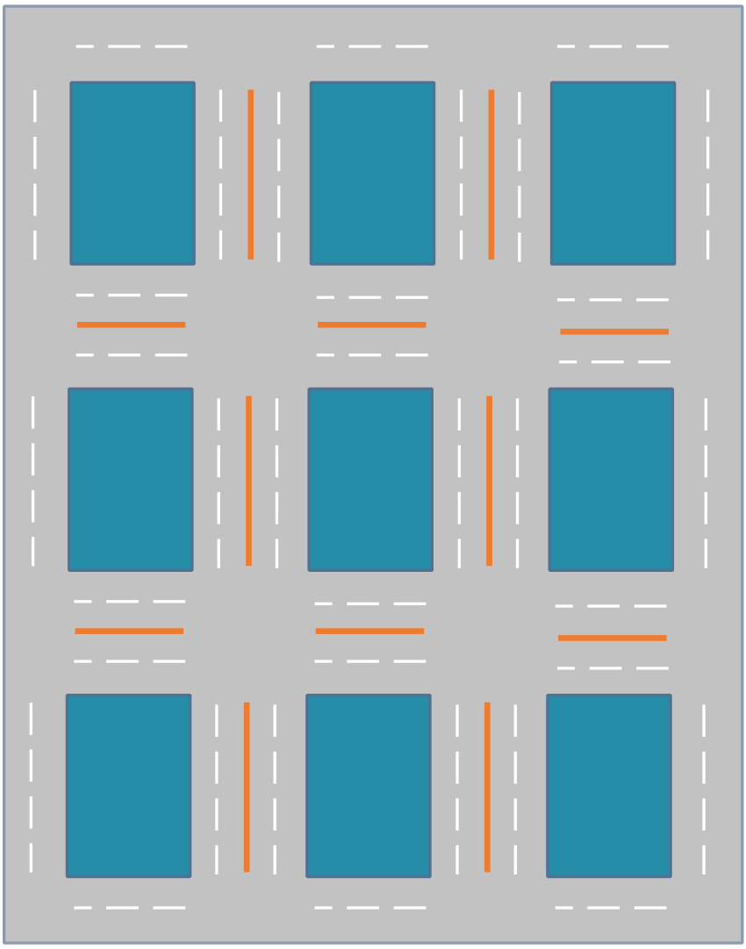


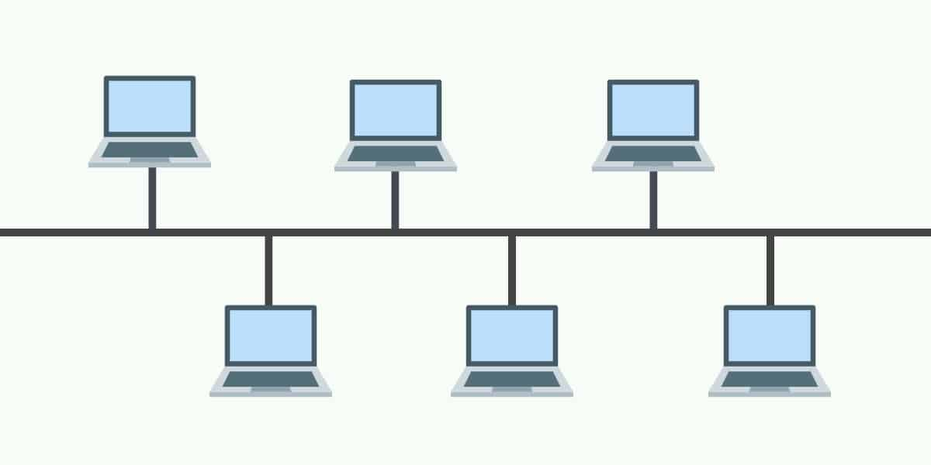
Patterns
Star
Gris/Manhattan
Ring
Bus
Tree
Mesh

Slide 8
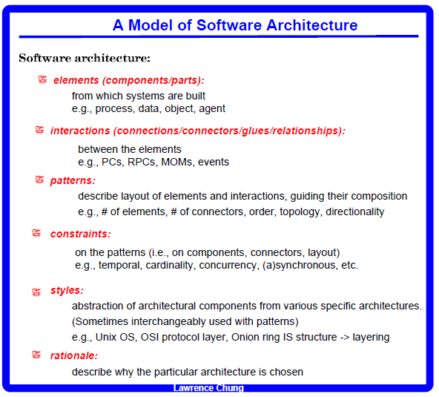

Slide 9
An Example of Software Architecture
A sequential compiler
Lexer
Parser
Semantic
Analyzer
Optimizer
Coder
Understand the difference between a software architecture and
a detailed design (data structure & algorithm)

Slide 10
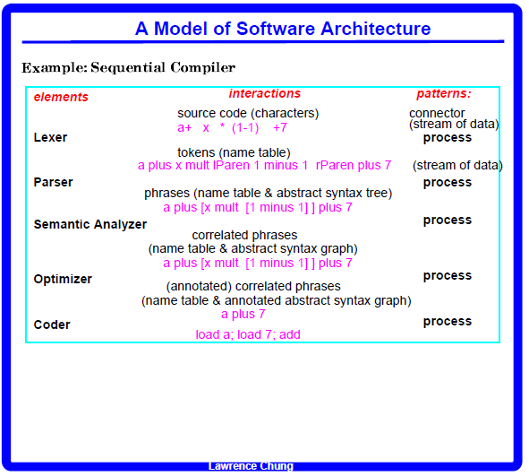

Slide 11
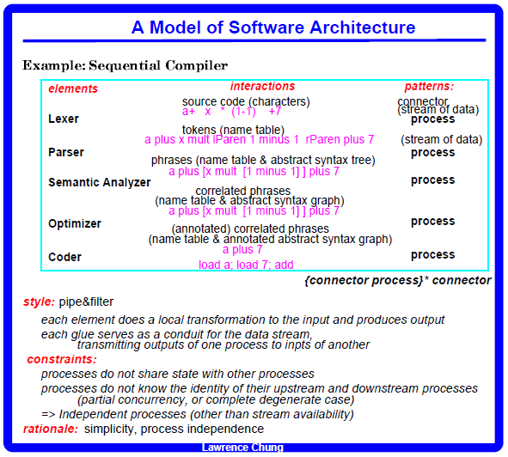

Slide 12
Understand the difference between a software architecture and
a detailed design (data structure & algorithm)
+
Data Structure: A parse tree
e.g., 2 + (9 – 2) * 4 / (3 + 5)
An algorithm (for the coder): Tree Traversal Algorithm
e.g., 2 + (9 – 2) * 4 / (3 + 5)

Slide 13
Pipe & Filter: appendum
Pipe & Filter in Unix
Show the use of multiple arch. Styles
Process architecture important, but there are other types of architectures too – What are they?

Slide 14
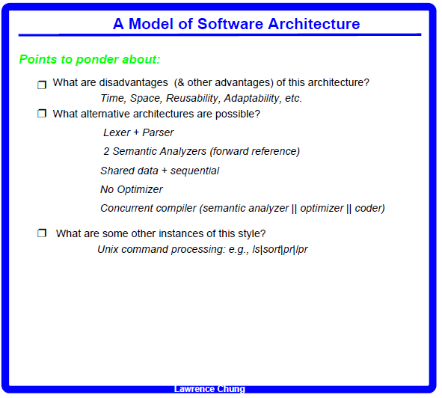

Slide 15
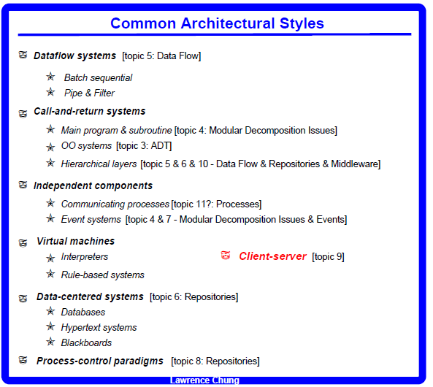

Slide 16
